Slide 1
MINI-PROJECT
ANALYSIS ON KICKSTARTER PROJECTS DATASET
BY MEGHNA SARKAR

Slide 2
INDEX
About the dataset
Kickstarter
Talend ETL Tool
Cleaning of dataset
Analysis

Slide 3
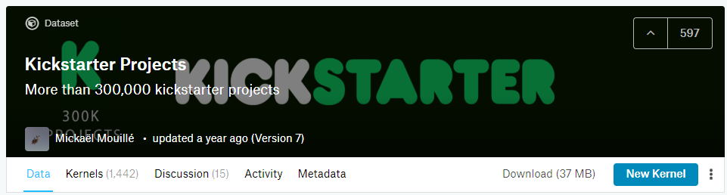
About the dataset
Source: Kaggle
Content: Each row has values for Project-IDs, project-names, country, launch-dates, amount pledged, deadlines, goal-amount, no. of backers, state of the project, categories & sub-categories to which the project belongs to.

Slide 4
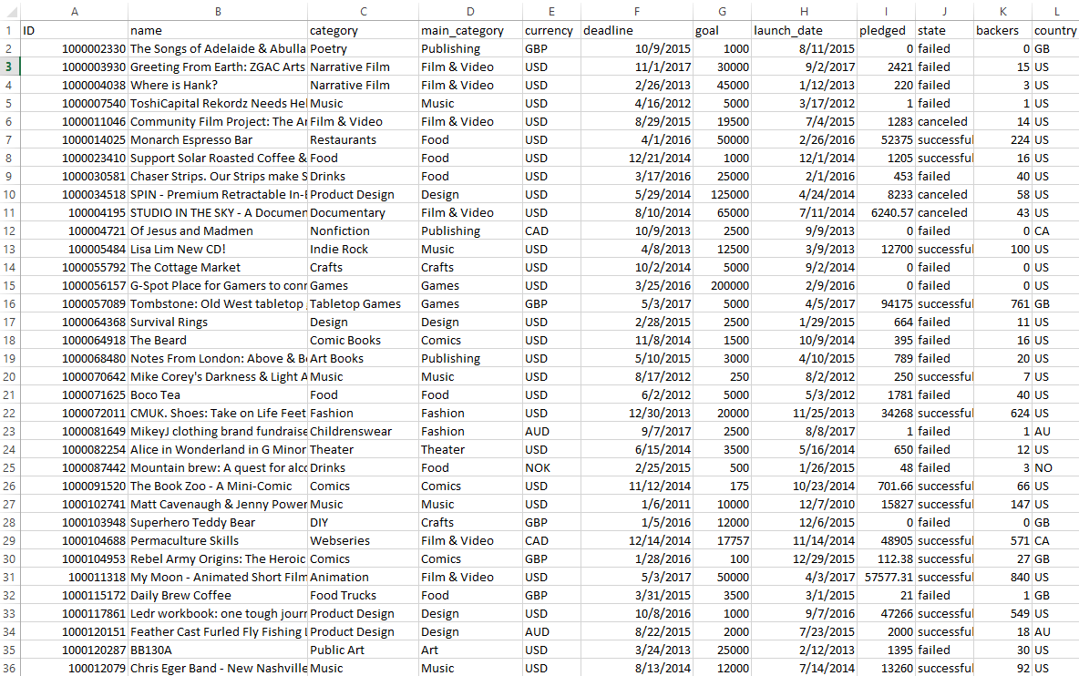

Slide 5
Kickstarter
Kickstarter is an American public-benefit corporation based in Brooklyn, New York, that maintains a global crowd funding platform focused on creativity and merchandising. The company's stated mission is to "help bring creative projects to life". Kickstarter has reportedly received more than $4 billion in pledges from 15.5 million backers to fund 257,000 creative projects, such as films, music, stage shows, comics, journalism, video games, technology and food-related projects.

Slide 6

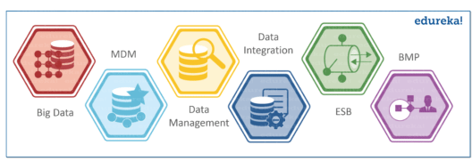
TALEND ETL TOOL
Talend is an open source data integration platform. It provides various software and services for data integration, data management, enterprise application integration, data quality, cloud storage and Big Data.

Slide 7
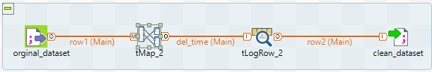
CLEANING OF THE DATASET
Created Metadata of the original dataset on Talend
Replaced unnecessary commas in certain columns to load dataset correctly
Got rid of the dates given alongside the launch date in the same column to avoid discrepancies

Slide 8
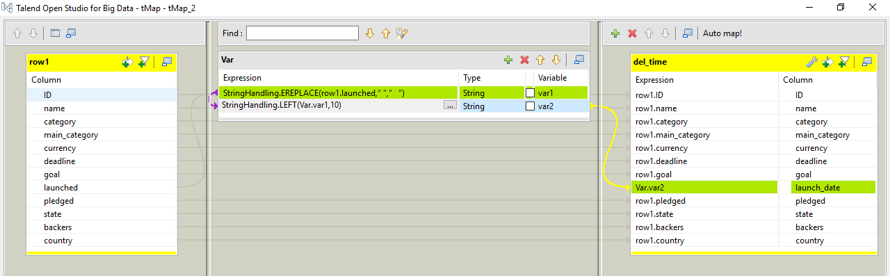

Slide 9
Analysis

Slide 10
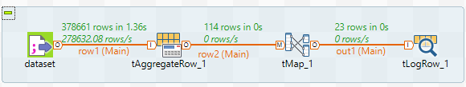
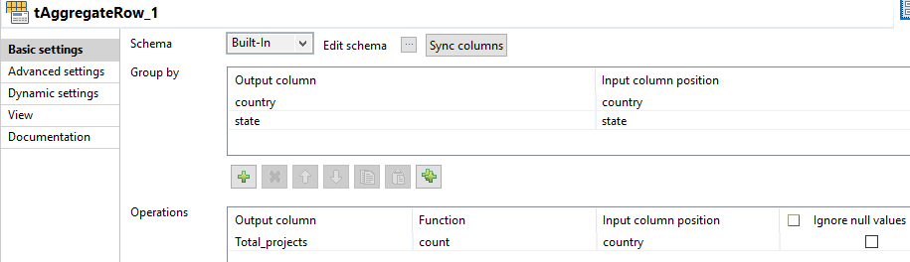
1. Total number of projects and successful projects from each country

Slide 11
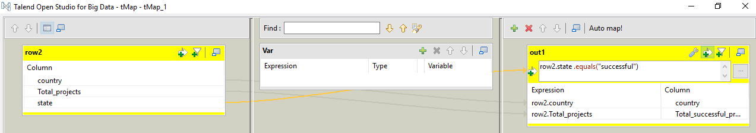
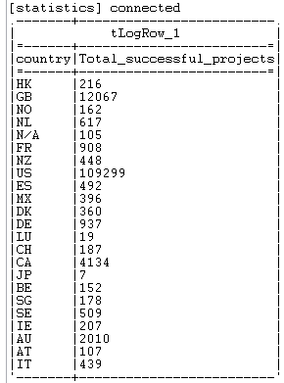

Slide 12
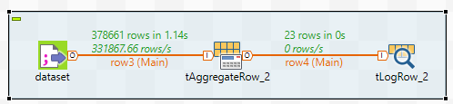
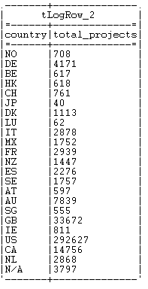
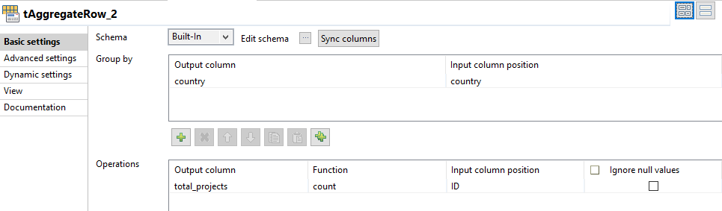

Slide 13
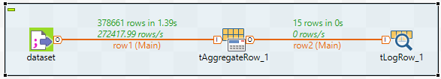
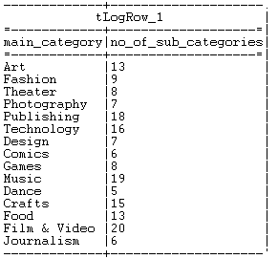
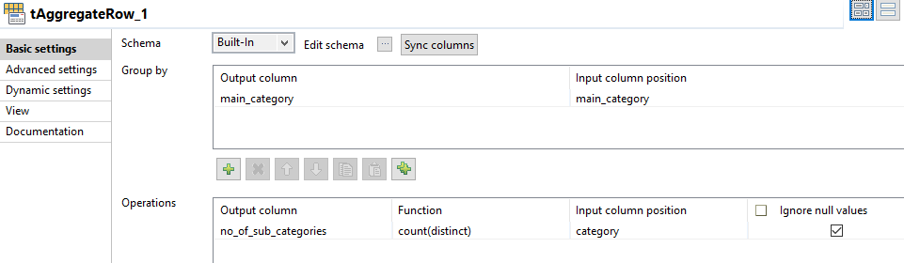
2. The various main categories and no. of sub-categories under each category

Slide 14
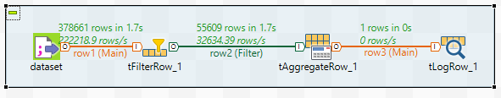
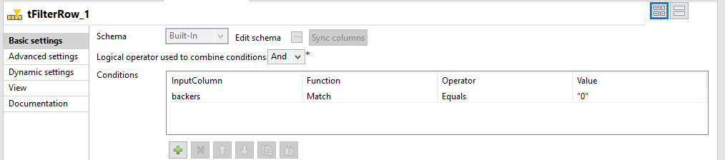
3. No. of projects without any Backers

Slide 15
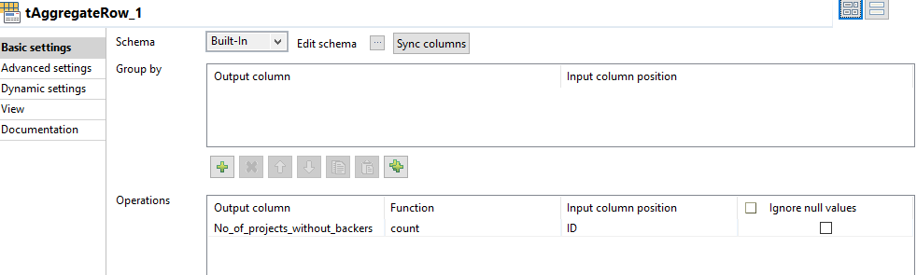


Slide 16

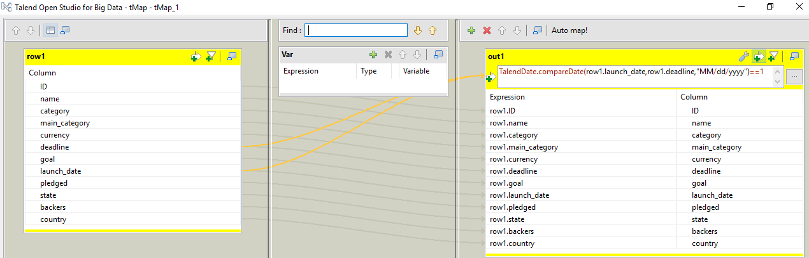
4. No. of projects which were launched after the deadline

Slide 17
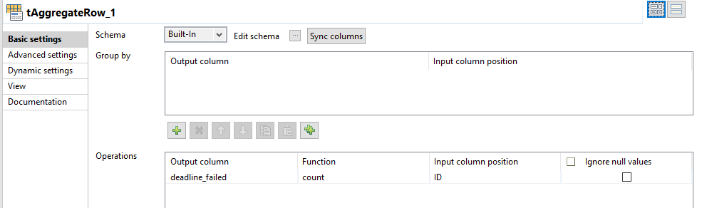


Slide 18
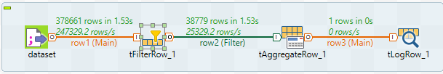
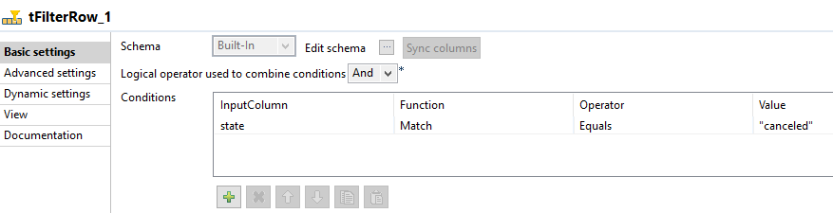
5. Number of projects that got rejected

Slide 19
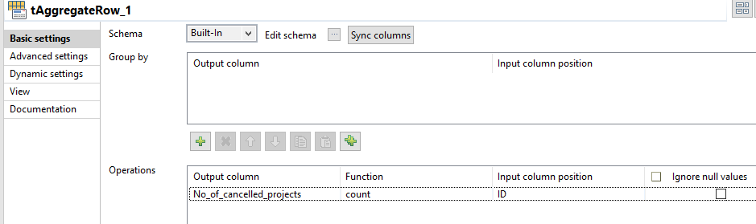


Slide 20
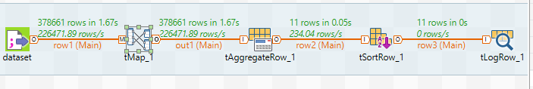
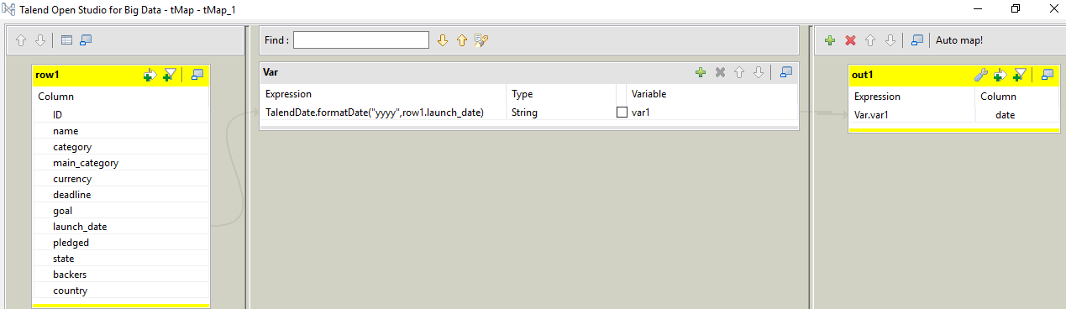
6. Number of projects launched year-wise

Slide 21
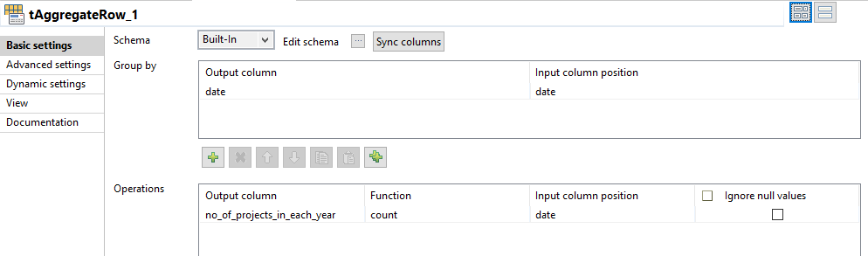
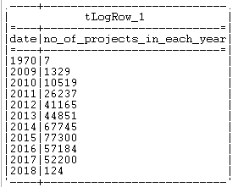
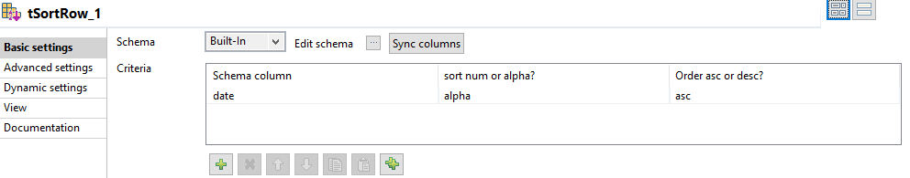

Slide 22
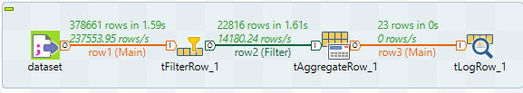
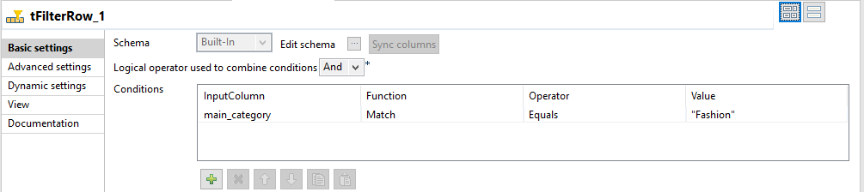
7. Number of projects from the main category ‘Fashion’ from each country

Slide 23
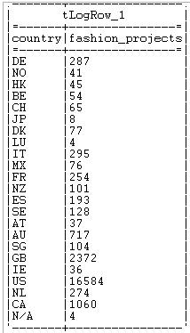
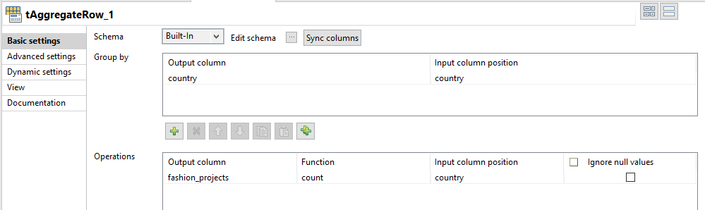

Slide 24
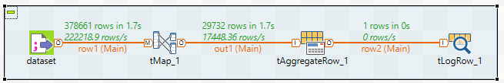
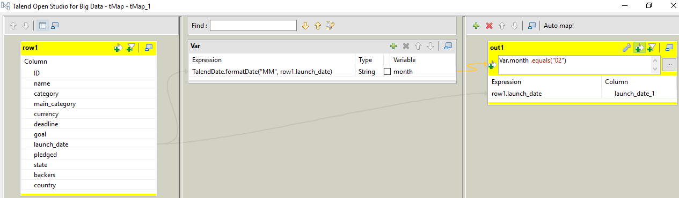
8. Number of projects which were launched in the month of ‘February’

Slide 25
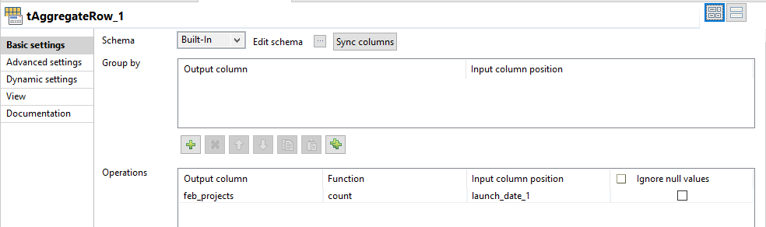


Slide 26
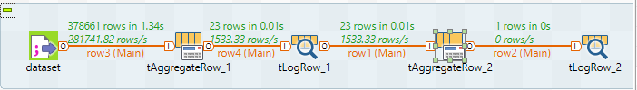
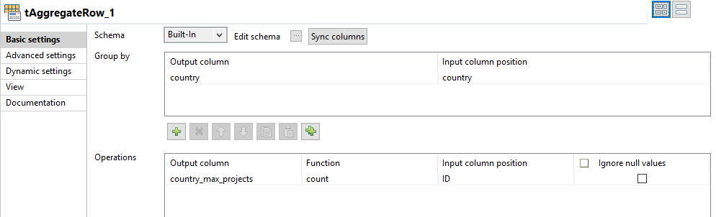
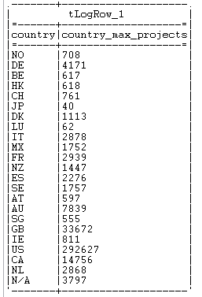
9. The country with maximum number of projects

Slide 27
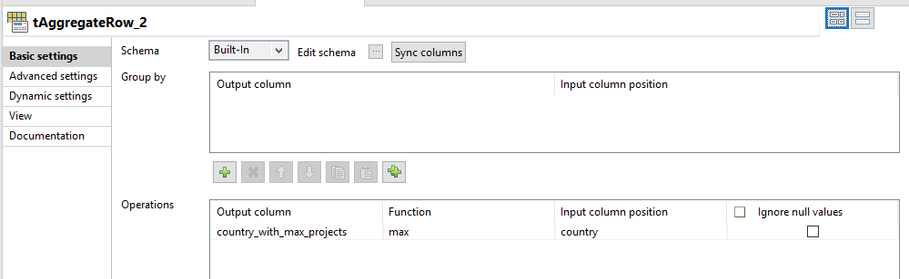
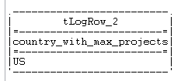

Slide 28
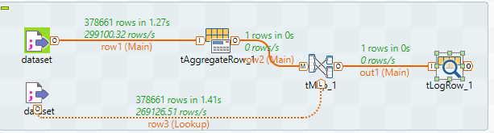
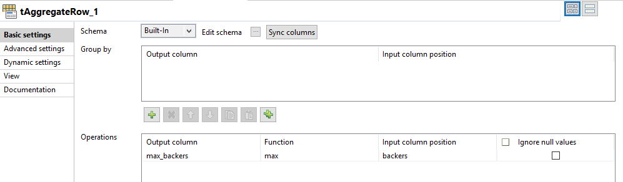
10. Project with maximum number of backers

Slide 29
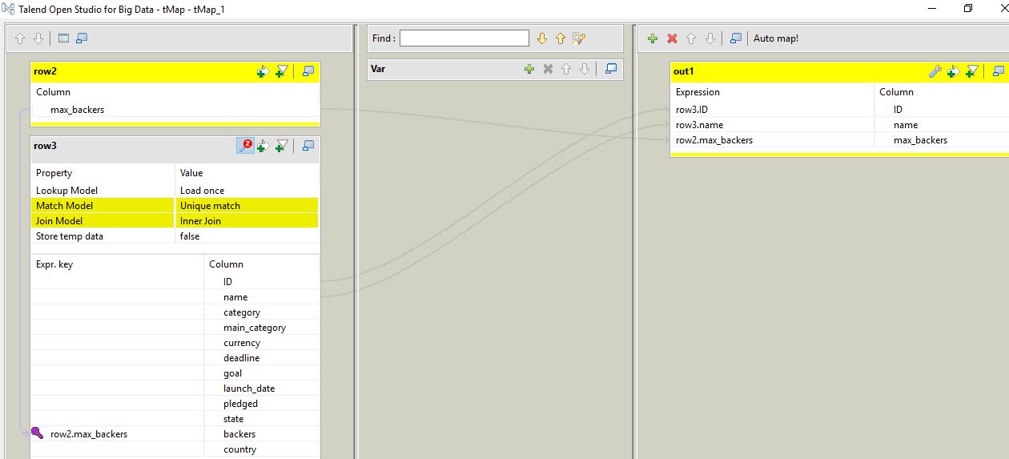


Slide 30
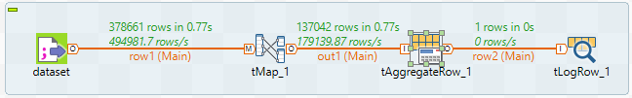
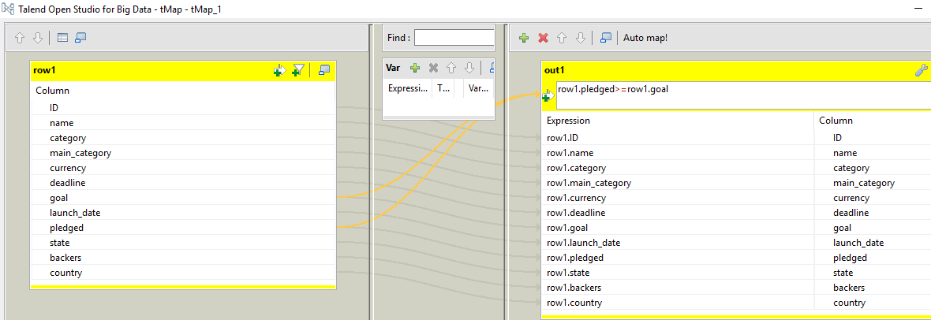
11. Number of projects that met their goal amount

Slide 31
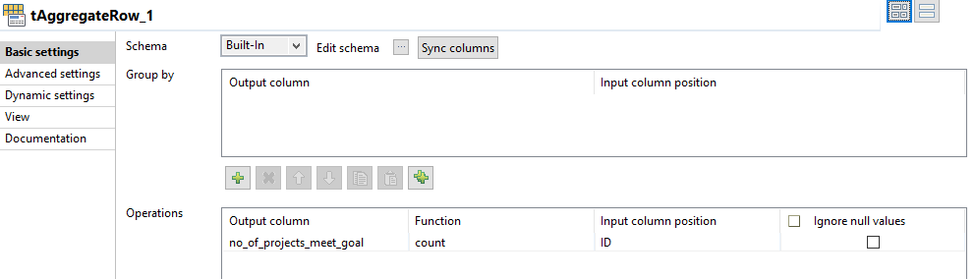


Slide 32
THANK YOU

